Slide 1
Neural Information in the Visual System
By
Paul Ruvolo
Bryn Mawr College
Fall 2012

Slide 2
Questions to Explore for Today
How is visual information encoded and transmitted in the brain?
What are the potential engineering applications of this understanding?
Are there underlying principles that explain this organization?
What is the role of experience and learning in this organization?

Slide 6
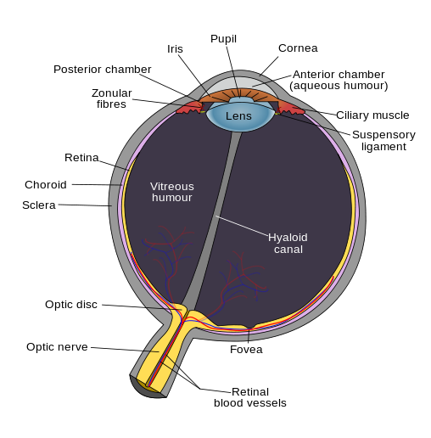
The Human Eye
Blindspot: http://www.tedmontgomery.com/the_eye/optcnrve.html
Notes:
This means that you have a blind spot where the optic nerve connects to the retina.
http://www.tedmontgomery.com/the_eye/optcnrve.html
Image source: wikipedia

Slide 7
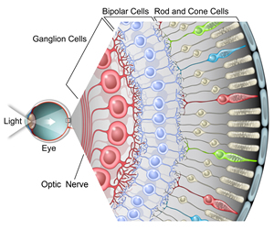
The Beginning of Visual Processing
Notes:
Image: Courtesy of Jamie Simon, Salk Institute for Biological Studies.

Slide 8
Retinal Ganglion Cells and Receptive Fields
To the brain
Axon
+
+
+
+
-
-
+
-
-
+
-
+
-
-
+
+
+
Receives input from photo receptors via Bipolar and Amacrine cells
Notes:
Add an example of filtering and then resulting spike pattern

Slide 9

Retinal Ganglion Cells
Retina
Retinal Ganglion Cells are localized in the visual field

Slide 10
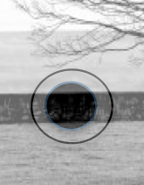
Retinal Ganglion Cells
Add pixel brightness in the outer ring, subtract those in the inner ring.
The higher this number is the more spikes the cell will produce (rate coding).
Also involved in detecting color contrasts.

Slide 11
Visual Perception
From last time: “Perception of the world is constructed out of the raw data sent to the brain by sensory nerves.”
In order to accurately perceive our visual world we need many retinal ganglion cells working together.
Matlab demo: /Users/paul/tmp/doReconstruction.m

Slide 12
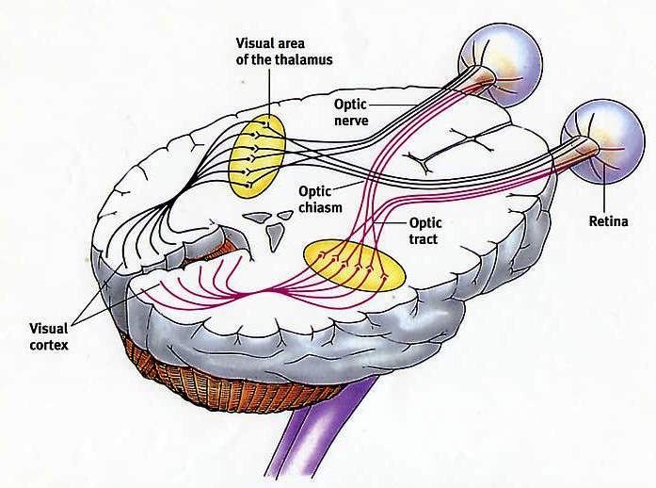
Pathway to the Cortex
Information is relayed from the eye through the LGN (Lateral Geniculate Nucleus) located in the Thalamus.
The LGN can is in part a relay station from the eyes to the visual cortex..
Largely leaves the input from the Retinal Ganglion Cells unchanged.
Notes:
http://camelot.mssm.edu/~ygyu/research.html

Slide 13

Optical Illusions (possibly based on Retinal Ganglion Cells)

Slide 14
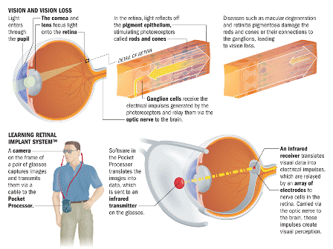
Potential Applications

Slide 15
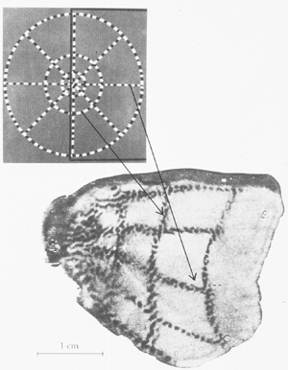
Primary Visual Cortex
Receives input from LGN and begins the cortical processing of visual information in the brain
Exhibits retinotopic mapping

Slide 16
Hubel and Wiesel 1959

Slide 17
Simple Cells
-
+
+
-
-
Respond to oriented bars of light
Diffuse lighting does not produce a response
Question for the class: how might we form these from inputs from the LGN?

Slide 18
Hubel and Wiesel Experiment 2

Slide 19
Complex Cell
Respond to bars of a particular orientation regardless of position within the visual field
Question for the class: how might we form a complex cell from individual simple cells?

Slide 20
Higher Level Visual Areas
V1 feeds to V2
V2 to V3 and so on
Each layer becomes a more abstract representation of the original input
Somewhat controversial: grandmother cells

Slide 21
Neurally Inspired Computer Vision
System architecture based on knowledge of neuroscience!
Serre, Wolf, and Poggio (2005).

Slide 22
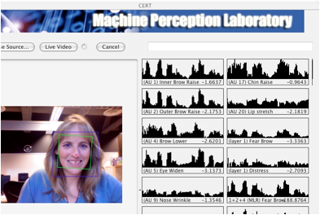
Neurally Inspired Computer Vision

Slide 23
Cracking the Brain’s Visual Code

Slide 24
Blakemore and Cooper (1970)
Watch video: http://www.youtube.com/watch?v=QzkMo45pcUo
Notes:
Aim:To investigate the development of the primary visual cortex, and to find out if some of its properties such as orientation selectivity were innate (as suggested by Hubel and Wiesel in 1963) or learned.
Method/Procedure: Laboratory experiment. Independent group design. Blakemore & Cooper (1970) randomly allocated and raised 2-week-old kittens in either a horizontal or vertical striped environment for 5 hours per day for five months. For the rest of their day the kittens were in darkness!
The two conditions of the independent variables were the environments within which the kittens were raised. The environments were either a drum with vertical stripes, or a drum with horizontal stripes. While in their respective drums the kittens wore cardboard collars, which enabled them only to look forwards.
The dependent variable was whether the horizontally raised kitten could detect vertically aligned objects, and/or if the vertically raised kittens could detect horizontally aligned objects.
‘The kittens did not seem upset by the monotony of their surroundings and they sat for long periods inspecting the walls of the tube.’ (Blakemore and Cooper, 1970).
Results: At five months the kittens were tested for line recognition. They showed ‘behavioural blindness’ in that those raised in horizontal environment could not detect vertically aligned objects, and vice-versa. Only the eyes of the cat brought up on vertical stripes followed a rod held vertically and shaken. They remained blind to contours perpendicular to the stripes they had lived with. The same thing was found with the horizontal cats. When microelectrodes were later placed into individual cells in their visual cortex, Blakemore and Cooper found that horizontal plane recognition cells did not ‘fire-off’ in those kittens from the vertical environment, and vertical plane recognition cells did not ‘fire-off’ in those kittens from the horizontal environment. They thus also suffered from ‘physiological blindness’.
Conclusions: Development of the visual cortex continues well after infancy, and that both before and after birth brain development is determined by the functional demands on the brain, (what it is called upon to do and deal with) rather than by preprogrammed genetic factors. The study strongly suggests that environment can determine perception at both a behavioural and physiological level: at least in cats.

Slide 25
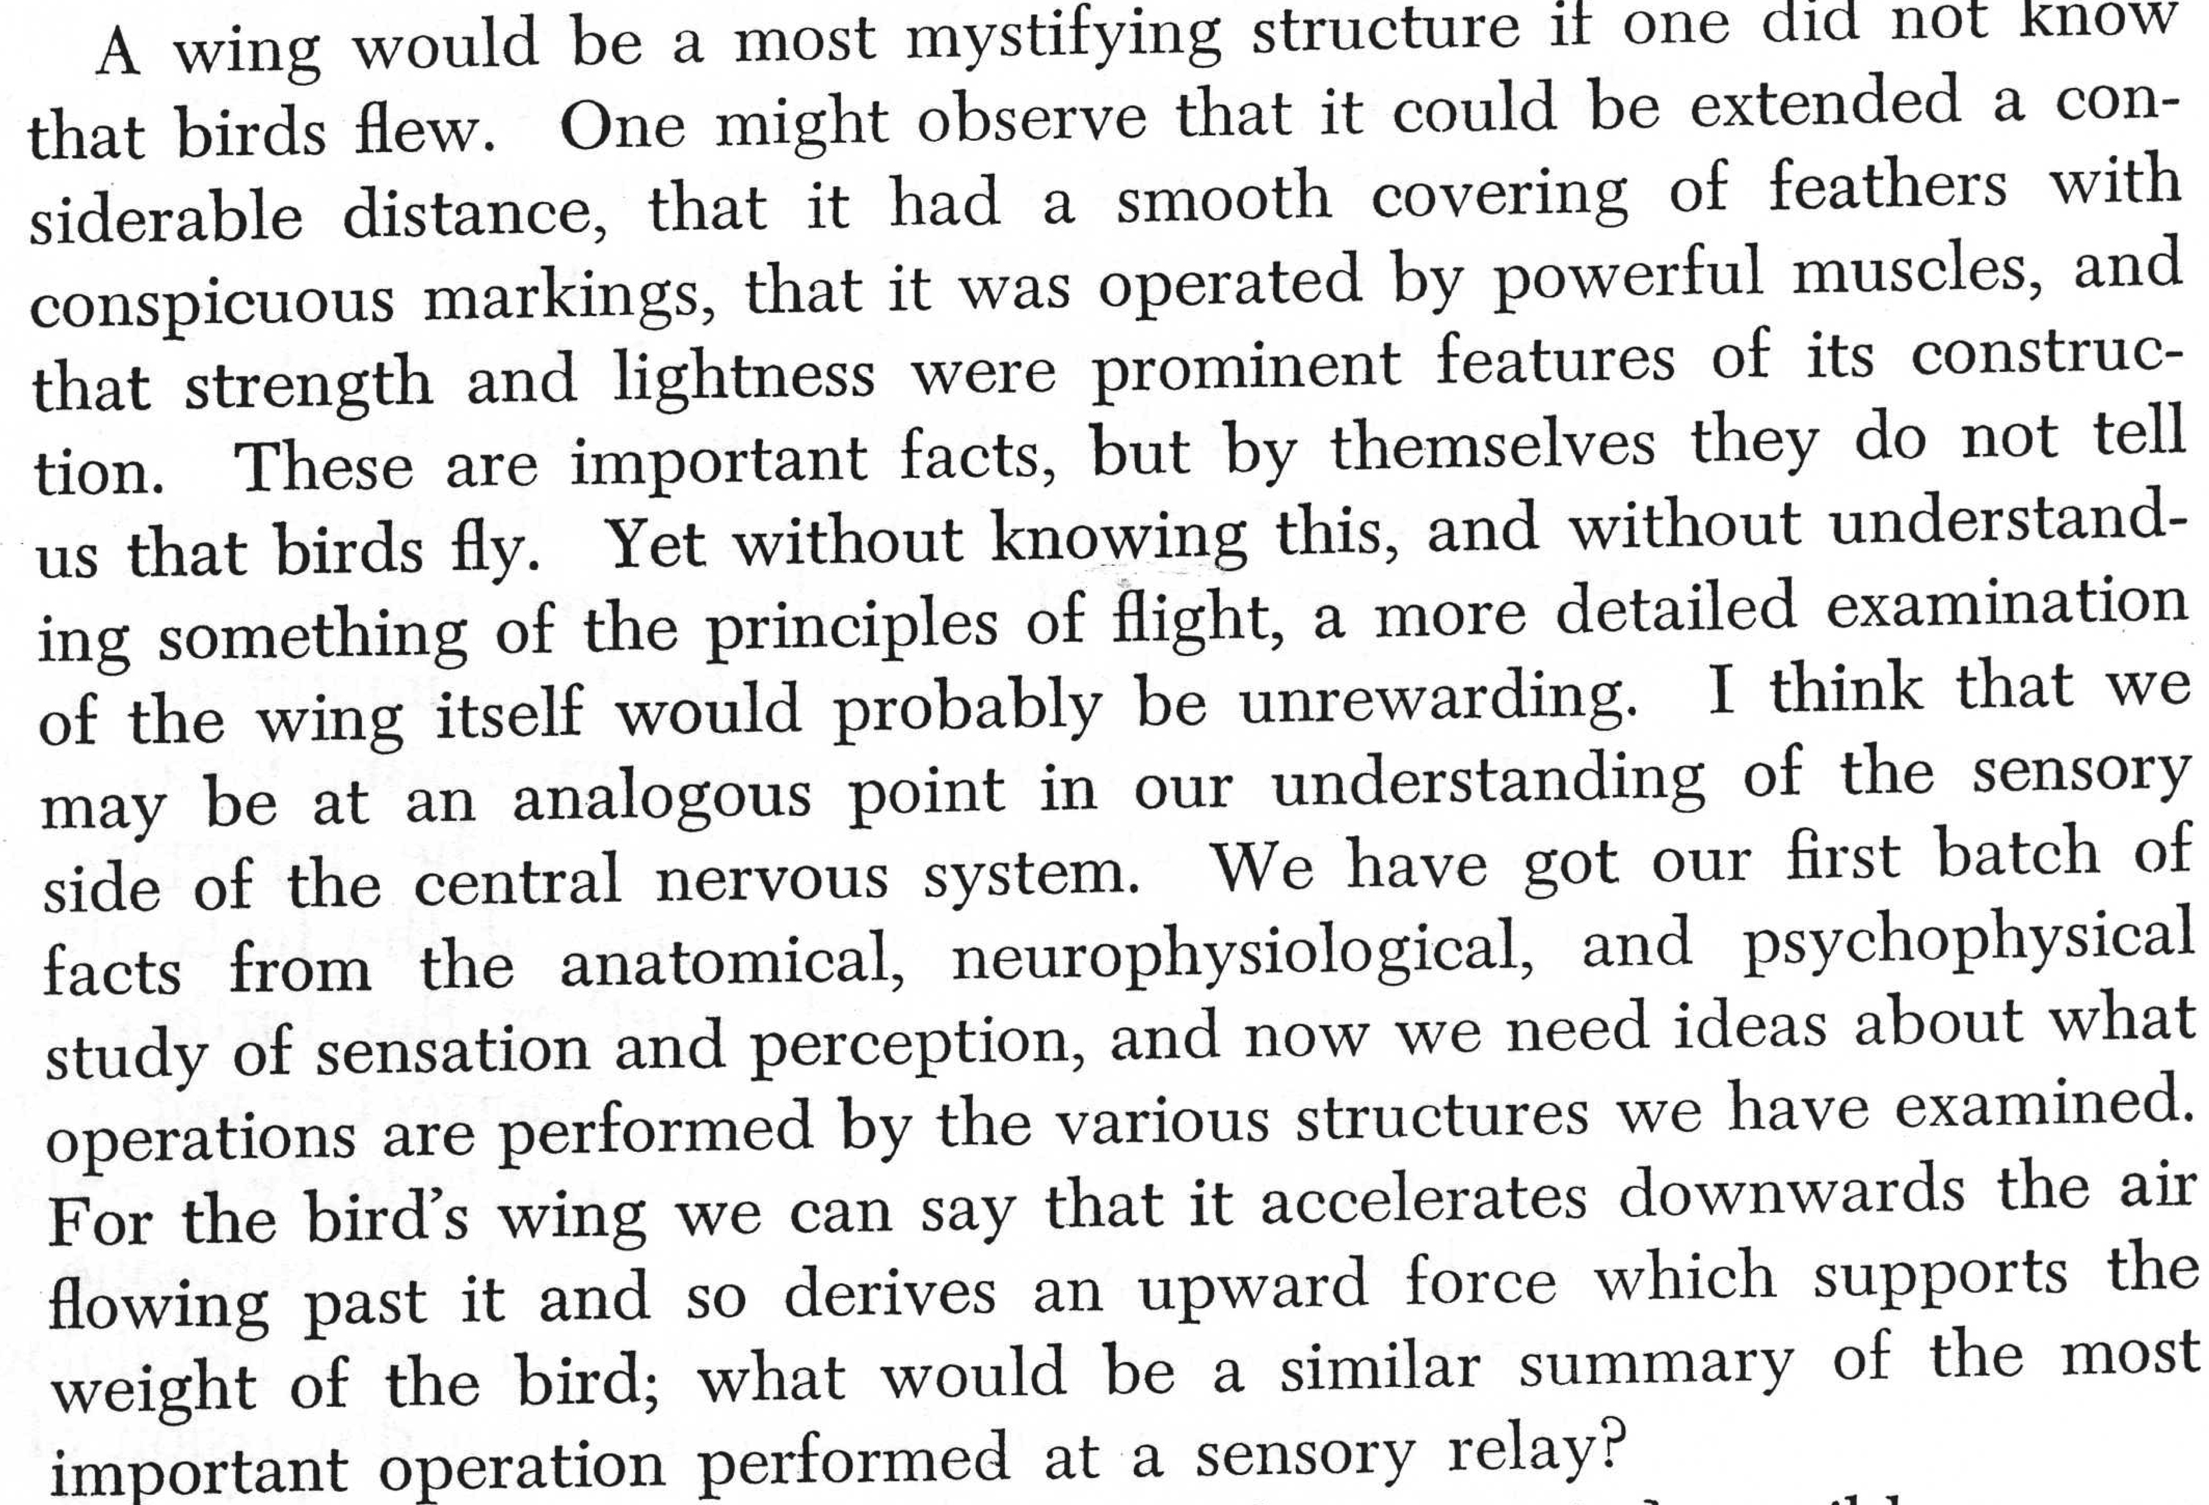
Barlow 1961

Slide 26
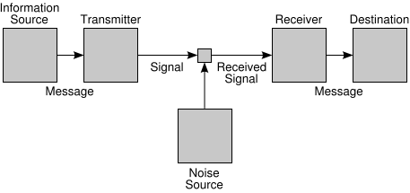
The View from Shannonland
An Image that falls on the retina
Optic Nerve to LGN
Primary Visual Cortex

Slide 27
Bell and Sejnowski 1997

Slide 28
What is the Best Neural Code?
Our goal is to choose the filters w such that the filtered image Y retains the most information about the input image X
We can maximize using using gradient ascent… The gradient simplifies to:

Slide 29
A Special Case: 1 input 1 output

Slide 30
What about 2 output units?
Redundancy
Generalization to N inputs and N outputs given in Bell and Sejnowski (1995).

Slide 31
Learned Filters

Slide 32
Spinoff Application: Solving the Cocktail Party Problem
http://cnl.salk.edu/~tewon/Blind/blind_audio.html
How might this be useful?

Slide 33
Is vision completely learned?
Goren, Sarty, and Wu (1975).
Johnson, Dziurawiec, Ellis, and Morton (1989).

Slide 34
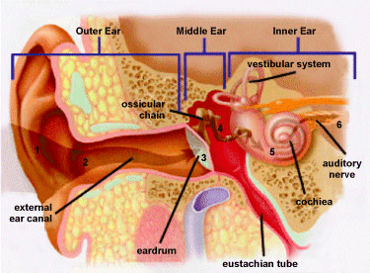
Brief Aside About Auditory Coding

Slide 35
Optimal Auditory Coding

Slide 36
Summary
Sensory processing centers of the brain are some of the most well-understood parts of the neural code.
Information theory gives us a theoretical framework to not only make predictions about the organization of the system but to answer the question of why the system is organized the way it is.

